Slide 1

BANGLADESH STUDENT PERFORMANCE ANALYSIS
An Excel Data Analytics Project exploring academic performance and identifying key factors affecting GPA and marks — powered by interactive dashboards.
EXCEL ANALYTICS
ACADEMIC RESEARCH

Slide 2


DATASET OVERVIEW
WHAT THE DATA CONTAINS
Student academic and demographic records
Study hours, attendance, and GPA
Family income and internet access
Data cleaned and transformed using Microsoft Excel for accurate analysis.

Slide 3


TOOLS & FEATURES USED
PIVOT TABLES & CHARTS
CONDITIONAL FORMATTING
Dynamic data summarization and visualization
Visual KPI cards for instant insight
SLICERS & INTERACTIVITY
Interactive dashboard with dynamic filtering

Slide 4

DATA CLEANING PROCESS
REMOVE
REMOVE DUPLICATES
HANDLE MISSING DATA
STANDARDIZE VALUES
A structured cleaning pipeline ensured data accuracy and consistency before any analysis was performed.

Slide 5

DASHBOARD & KPI METRICS
2
1
KPI CARDS & SLICERS
INTERACTIVE DASHBOARD
Avg GPA & Avg HSC Score
Dynamic filtering for easy category comparison
Slicers enable instant cross-category comparisons with a single click.

Slide 6

GENDER & STUDY HOURS ANALYSIS
KEY FINDINGS
Male and female performance compared across metrics
Students studying more hours consistently scored higher grades
Strong positive correlation between study time and marks

Slide 7
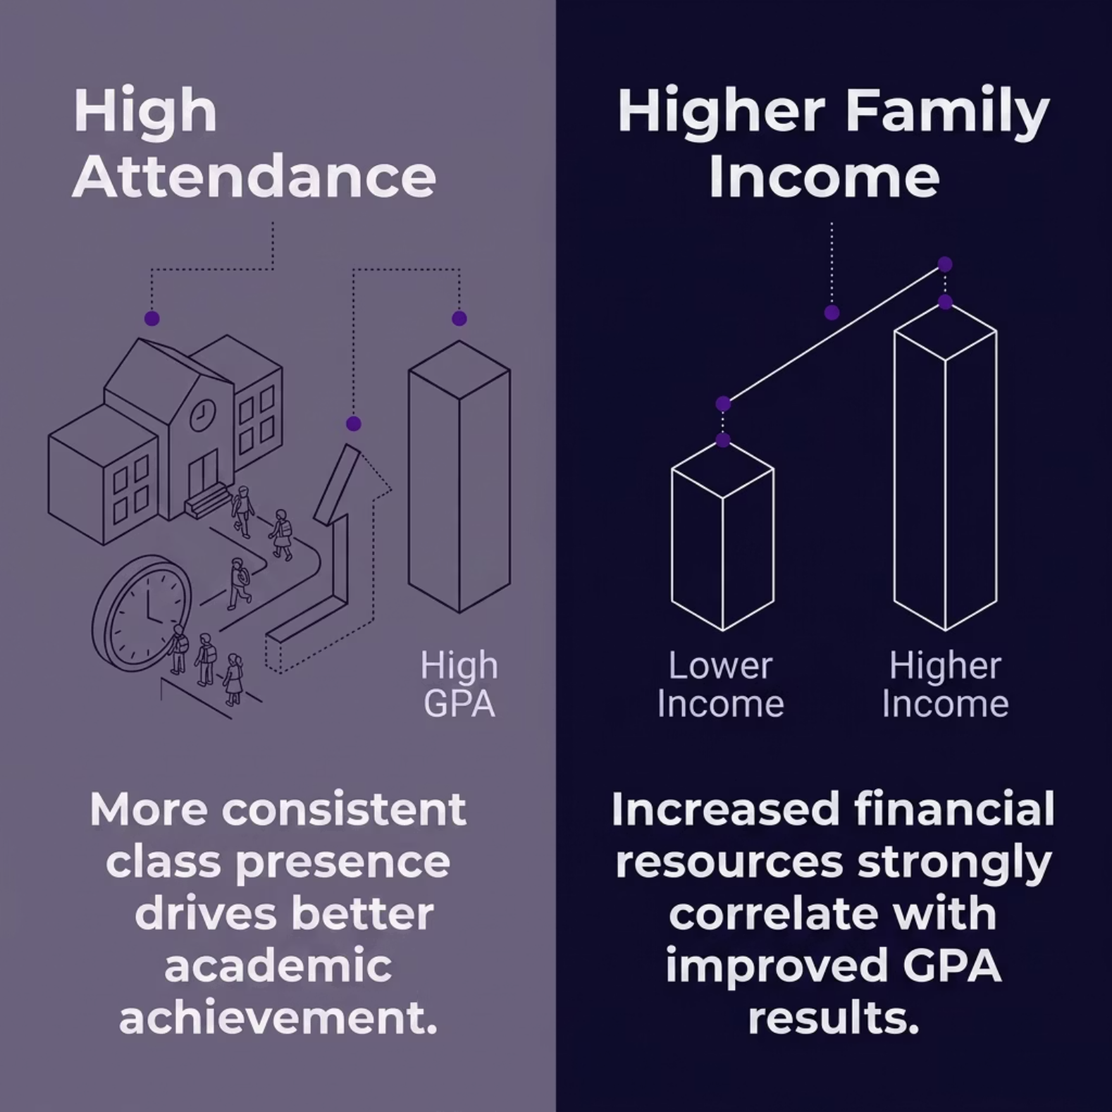

ATTENDANCE & FAMILY INCOME ANALYSIS
WHAT THE DATA SHOWS
High attendance students achieved better performance
Family income significantly impacts educational outcomes
Income categories compared directly against GPA scores

Slide 8

INTERNET ACCESS & DISTRICT ANALYSIS
INTERNET ACCESS
Students with internet access performed measurably better academically.
TUITION SUPPORT
Tuition assistance positively affected overall scores.
DISTRICT COMPARISON
District-wise analysis identified top and low-performing regions across Bangladesh.

Slide 9
KEY INSIGHTS & CHALLENGES
TOP INSIGHTS
CHALLENGES FACED
Study hours & attendance strongly influence GPA
Data cleaning and handling inconsistencies
Selecting the right visualizations
Dashboard layout and formatting
Internet access improves learning outcomes

Slide 10

CONCLUSION & FUTURE IMPROVEMENTS
CURRENT SUCCESS
Excel effectively supports educational data analysis with clear decision-making insights.
FUTURE PLANS
Power BI dashboards, predictive analytics, and automated reporting.
Thank You — Questions & Answers

